Slide 1
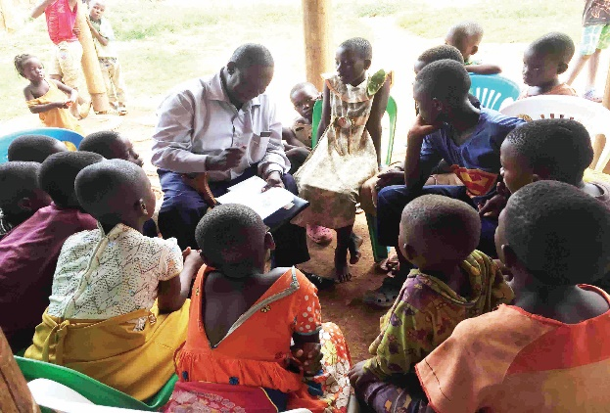
MOTHER TONGUE: IMPROVING LITERACY LEVELS THROUGH PARENTAL PARTICIPATION
Commission member Fred Lukabwe talking to children of Katoogo- Kinawataka in Uganda, during the piloting of the Parent Engagement Needs Assessment tool.
LUGANDA/LUSOGA/LUGWERE VEHICULAR CROSS-BORDER LANGUAGE COMMISSION
A paper presented by Margaret Nankinga at the 11th Pan African Literacy Conference- Serena Hotel, Uganda, AUGUST 20- 22, 2019

Slide 2
INTRODUCTION
Whereas researchers and educationists agree that for a child to start reading in a language he / she understands well is key to literacy achievements, realising the full benefits of this approach still eludes literacy practitioners.

Slide 3
INTRODUCTION (cont’d)
This paper will discuss two reasons for this failure; the poor implementation of bilingual education, and lack of relevant parent/ caregiver support.

Slide 4
Bilingual education: What is versus what should be
l Very little Mother tongue education, children leave before they have hardly attained proficiency
l Subtractive instead of additive bilingual education

Slide 5
Bilingual education(cont’d)
Informal use of mother tongue at upper primary, not organised and well planned, and as a result the benefits that would accrue from such a dual system of language instruction are not fully realised.

Slide 6
Bilingual education(cont’d)
A comparison of number of L1 languages spoken by pupils with number of languages of instruction used in class in selected rural schools

Slide 7
Bilingual education(cont’d)
This informal use should be explored because of its benefits of;
(i) Making the pupils understand better and therefore be able to put to use what has been learnt .
(ii) Leading to high levels of proficiency in both the mother tongue and the foreign language.

Slide 8
Lack of relevant parent/ caregiver support
Reasons for the lack:
Failure to catch parents interest
Failure to link home learning to school education
Feel of Irrelevancy : Parents feel that the social, cultural and linguistic knowledge they have is either lacking or irrelevant to the formal school education.

Slide 9
Relevant parent/caregiver support (cont’d)
If parents are to engage in the literacy processes of their children, mother tongue is key and used properly can support the acquisition of other forms of literacy as demonstrated in the literacy samosa diagram below:

Slide 10
Literacy samosa

Slide 11
Lessons from Tusomere Wamu literacy project
According to the project’s endline report, by the end of the study, the number of teachers who felt that parents should read to their children had dropped (from 12.2% to 10.6%

Slide 12
Lessons from Tusomere Wamu literacy project (cont’d)
Whereas the campaign led to the rise in number of parents reading to their children from 9% to 30%, the number of parents unable to read who felt they could not help their children read, also rose from 67.4% to 84%

Slide 13
Lessons from Tusomere Wamu literacy project (cont’d)
In literate- semi illiterate- illiterate communities it is critical that practitioners determine which tool will work for which group.

Slide 14
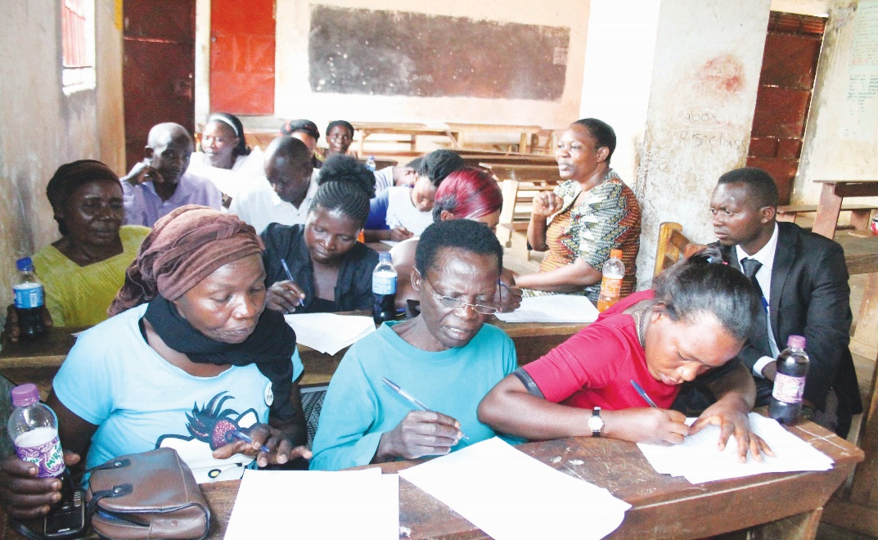
Lessons from Tusomere Wamu literacy project (cont’d)
Residents of Mutetema- Mityana in Uganda, filling questionnaire during the piloting of the Parent Engagement Needs Assessment tool.
Literacy partners need to study the communities they are targeting so as to determine suitable interventions.

Slide 15
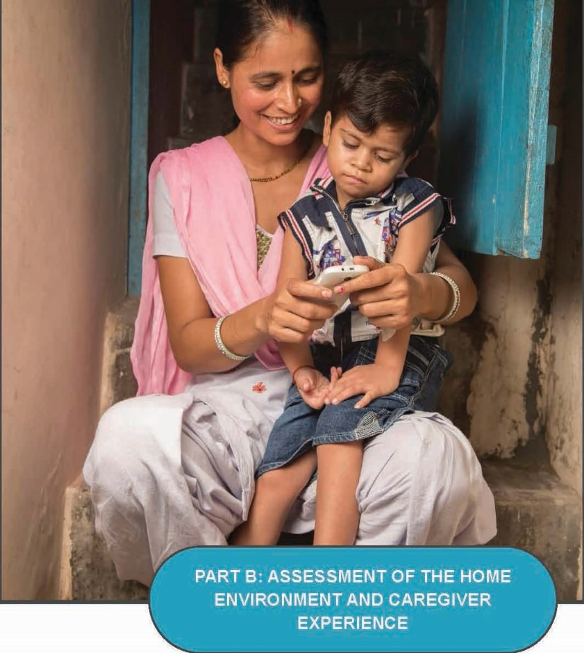
Parent Engagement Needs Assessment tool
https://educationinnovations.org/sites/default/files/Parent%20Engagement%20Needs%20Assessment_A%20Guide%20for%20Literacy%20Practitioners.pdf

Slide 16
Parent Engagement Needs Assessment tool
Project Literacy Parent Engagement Working Group, one of the five working groups within the Project Literacy Community of Practice, which established by Pearson’s Project Literacy and Results for Development (R4D) in 2018, developed the tool to guide literacy practitioners in positive parent/ caregiver engagement.

Slide 17
Parents Engagement Needs Assessment tool (cont’d)
The Community of Practice virtually convenes over 100 literacy practitioners from 20 countries. Some of these are; Literacy4 All, We Love Reading, Indus Action, Worldreader, The Reach Trust, The Parent- Child Home Program, Beyond the Classroom, Queen Rania Foundation, Iris Speaks, Child dream Foundation, Luganda/Lusoga/Lugwere Vehicular Cross-border language Commission, Tushinde Children’s Trust and Family support and Rescue Organisation.

Slide 18
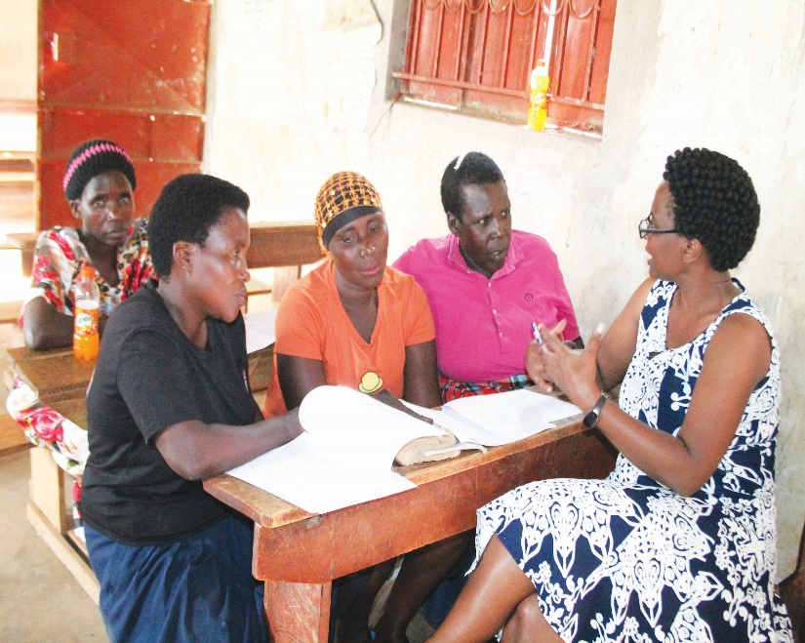
How the tool supports literacy practitioners
Commission member Pamela Batenga (right) discussing with residents of Mutetema- Mityana in Uganda, during the piloting of the Parent Engagement Needs Assessment tool.
It provides easy to use guidance on determining the realities, beliefs, needs and resources of the community, building local ownership and customized strategies

Slide 19
How the tool supports practitioners (cont’d)
It Provides guiding principles on how to engage and empower parents and caregivers.
It takes a human centred approach, allowing the communities to own programs
It is based on the principle of valuing and respecting the communities
It measures progress in a way that is meaningful to parents and caregivers.

Slide 20
How the tool supports practitioners(cont’d)
The tool also includes how and why assess home environment and caregiver experience.
It is intended to increase parental engagement, identify and control practitioners’ biases and assumptions

Slide 21
Who the guide is for
Literacy practitioners who work in low or illiterate communities
Literacy advocates
Designers and implementers of parent engagement programs
Evaluators of these programs

Slide 22
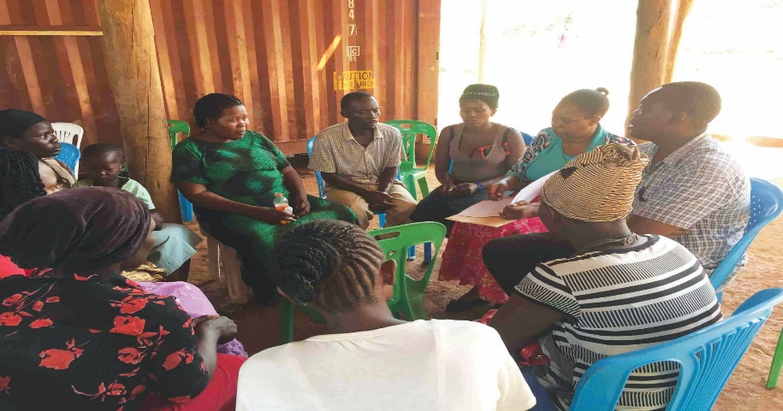
How to use the tool
Commission Coordinator, Margaret Nankinga, discussing with some of parents of Katoogo- Kinawataka in Uganda, during the piloting of the Parent Engagement Needs Assessment tool.
(a) The guide contains two main sections. The introduction outlines a set of guiding principles

Slide 23
How to use the tool (cont’d
(b) The framework section provides a series guiding questions to help you assess the broader literacy context.
© For more information about the tool please sign in to the webinar. (https://r4d.us1.list-manage.com/subscribe?u=6c3212a6ca42b75aaead60ceb&id=48251c378a)

Slide 24
How to use the tool (cont’d)
Literacy parents who work to improve parents/ caregivers participation in their children’s literacy processes should make use of the Parent Engagement Needs Assessment tool for better results.

Slide 25
RECOMMENDATIONS
(1) In order to bring about equity, Africa governments should review their language policies so as to come up with the right education and development policies

Slide 26
RECOMMENDATIONS
(2) The thematic curriculum should be reviewed and an additive approach to mother tongue as language of instruction be taken up.

Slide 27
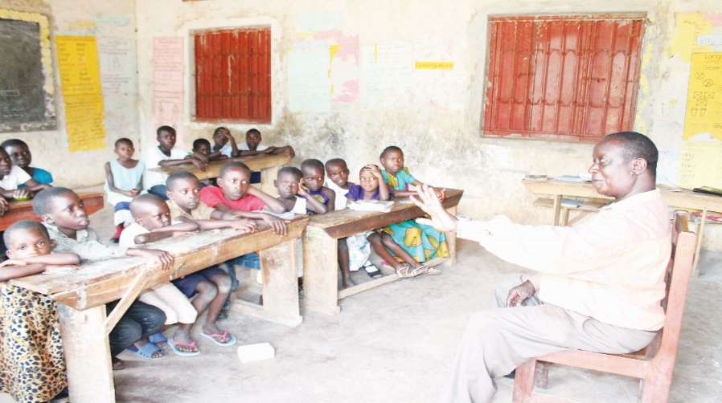
Recommendations
(3) Teachers should support parents’ participation through strengthening and linking classroom to home learning.
Commission member Fred Lukabwe talking to children of Mutetema- Mityana in Uganda, during the piloting of the Parent Engagement Needs Assessment tool.

Slide 28
CONCLUSION
Mother tongue and parents/ caregivers’ participation are crucial and play an integral role in a child’s literacy acquisition processes. Mother tongue literacy, done correctly, can lay foundation and boost all forms of literacy.

Slide 29
Conclusion (cont’d)
It empowers parents to participate in their children’s literacy processes as it eliminates the language barrier which is usually a limitation to many parents’ participation in Uganda and Africa as a whole.

Slide 30
Conclusion (cont’d)
Parents need the right interventions so as to boost their participation and for this to happen practitioners need to determine the right interventions to cater for different parents, different contexts, work with parents to identify problems and come up with customized strategies and solutions for different contexts.

Slide 31
Thank you Mwebale nnyo Asante sana

